Slide 1

Dr. Smita Gutgutia’s Clinic:
An overview of Clinic Management Software
- a solution from ZaR TechnoSoft

Slide 2
About zar technosoft
We are a small startup, driven highly motivated and experience individual to provide software solution for different verticals such as Hospitals, Hotels, schools etc. We are optimized and correctly tuned to deliver clients needs with professional excellence with personal touch.
Since inception at Zar , we are constantly inventing products and technologies to provide personalized solutions for different industries.
Why work with us,
Since we are startup, we are very much focus to our client and go extra miles for client satisfaction
Leverage Open Source Proven Technologies to minimize cost without compromising on quality
Commitment to quality.
Driven by passion.
We are a group of three individuals from different fields:
Mr. Ruhul Amin Mazumdar ,
Mr. Abrar Alvi
Mr. Zaved Akhtar Ahmed

Slide 3
About us
Ruhul Amin Mazumder (Solution Architect), born in 1981 is a technology enthusiast. Have more than 10 years of development experience and worked on large set of projects ranging from industry leading security products to application life cycle products. Have proven experience in developing web portals with rich UI. At heart wanted to become a data scientist and that why currently pursuing Mtech from BITS Pilani (WILP) specialized in Data Analytics. If not coding you will find him making robotics projects with arduino, raspberry PI , beagle bone black. His favorite time pass is tinkering electronics components with his little kid.
Abrar Alvi (System Devloper), is Computer Science and Engineering Graduate from Anna University. Have more than two years of experience in MNC .His work experience includes working for Banking projects and e-Governance projects. Currently working for Govt of Assam e-Governance project as a Java Developer. Passionate about Developing Java Applications, Web Design, HTML/CSS, beautifying things and Problem Solving.
When he is not in front of his computer you will find him playing his violin, visiting new places and cooking on Sundays.
Zaved Akhtar Ahmed (Presales Consultant), is a Cost Accountant who has more than 7 years work experience in Accounting and Customer Service Industry.
Handled different Markets such as Germany, and Switzerland, and North America.
I am a fluent multi Lingual, who can flawlessly speak German, English French, Hindi, Bangla and Assamese.
Networking is of particular interest to me and I have done my CCNA Routing and Switching

Slide 4
Proposed views
Registration view
Billing View
Doctor view (online – read only)
Admin view
Management view
Patient view (online – read only)

Slide 5
Front Office / registration view
Front Office : This is the registration view
Dashboard : Multiple appointment calendar for doctors
Register a new patient.
Make current appointment.
Make advance appointment / cancel an appointment.
Add details to the appointment sheet.
Route to doctor queues

Slide 6
Doctor view
Doctor View
Dashboard :
Todays appoint count.
Total Patient count.
Average patient wait time.
Top 10 - Disease trend.
Todays appointment table
Doctor Appointment calendar
Patient list (Search) - Patient History
Create Prescription for the patient - Sign off
Doctor will have to enter diagnose disease and portal will recommend medicine and appropriate doses based on age of the patient.
Doctor will have the option to change and insert.
The prescription can be printed for the patient and save in patient profile.

Slide 7
Billing view/ management view
Billing view
- Take advance
- Final Settlement/ Refund
-
Management View

Slide 8
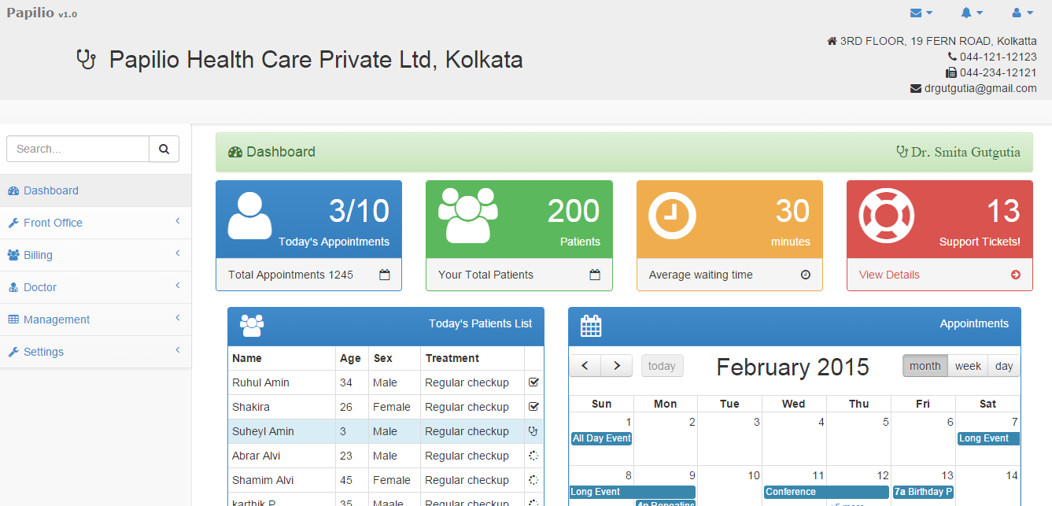
Doctors View Dashboard:
The dashboard will contain widgets for various features provided to the doctor.
This widgets will help the doctor to stay updated with their daily appointments, waiting time, number of patients, patient list, monthly weekly views.

Slide 9
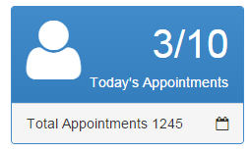
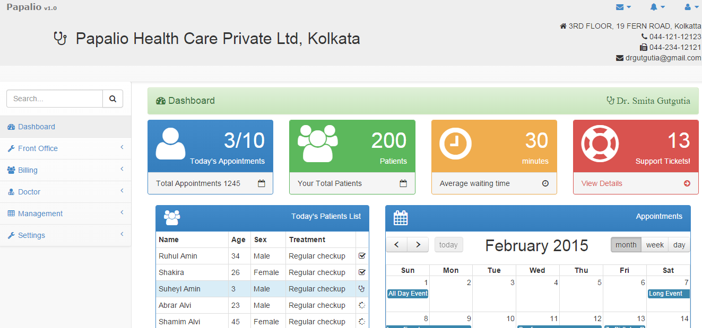
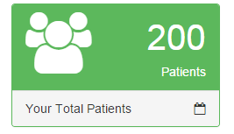
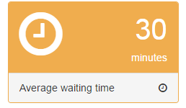
Dashboard Widgets:
The top three widgets will give the doctor counts like:
Out of 10 appointments for today 3 appointments are completed. Total number of appointments. Total number of patients. Average waiting time.

Slide 10
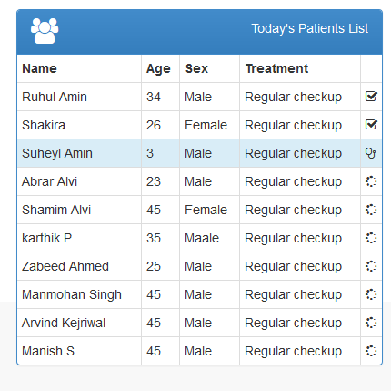
Today’s Patients List:
Todays patient list will describe the patient name, age, sex, type of treatment, and checked or unchecked.

Slide 11
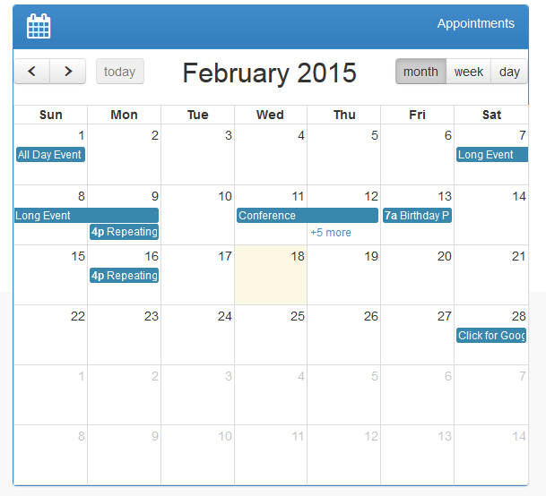
Doctors Appointments Calendar (Monthly View):

Slide 12
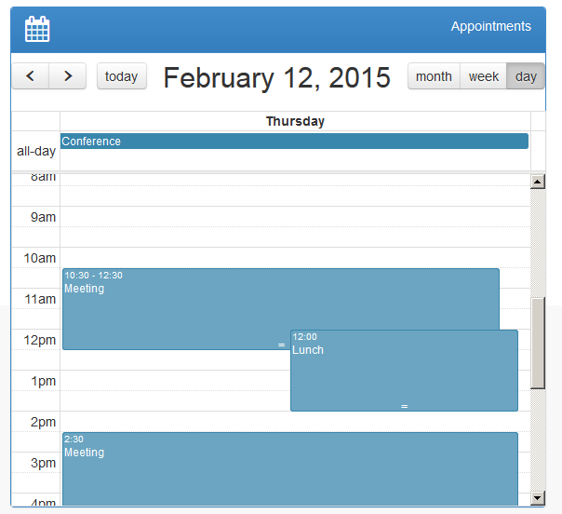
Daily View Calendar:

Slide 13
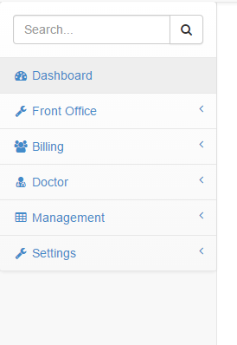
Responsive User Interface Rendered in Mobile devices:

Slide 14
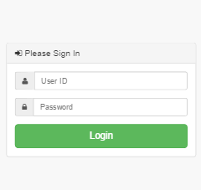
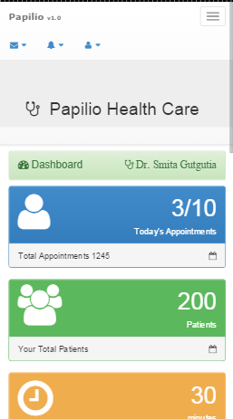
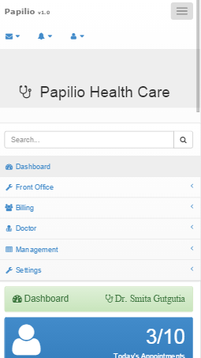

Slide 15
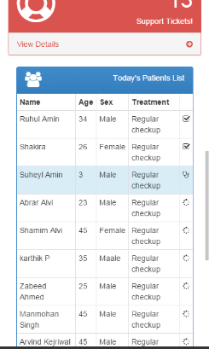
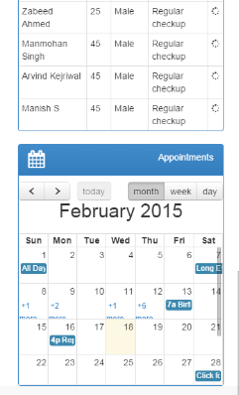
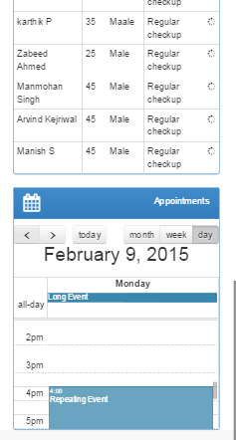

Slide 16

Questions and Feedback :

